Slide 1

UK Railway Revenue Analysis
This presentation provides a comprehensive analysis of the UK railway revenue, examining key trends and factors influencing financial performance. As we analyze into the passenger demand patterns, the impact of train delays, and revenue streams, Our goal is to derive insights to support decision-making, informed strategic planning and operational improvements. Through clear visuals and detailed data, we aim to provide a complete overview of the revenue landscape.

Slide 2
Peak Hours by Departure Time
Morning Peak (6:00 - 9:00)
Evening Peak (16:00 - 19:00)
Off-Peak Hours
The morning peak reflects the daily commute, with most departures occurring between 7:00 and 8:00. This period requires maximum capacity and efficiency to manage the high volume of passengers travelling to work and educational institutions.
The evening peak sees another surge in departures, as commuters return home. The volume is typically spread more evenly across these hours compared to the morning peak, but remains a critical period for operational management.
Off-peak hours represent opportunities for maintenance, reduced staffing, and targeted marketing to encourage travel. These periods can be optimised to enhance overall system efficiency and revenue.

Slide 3
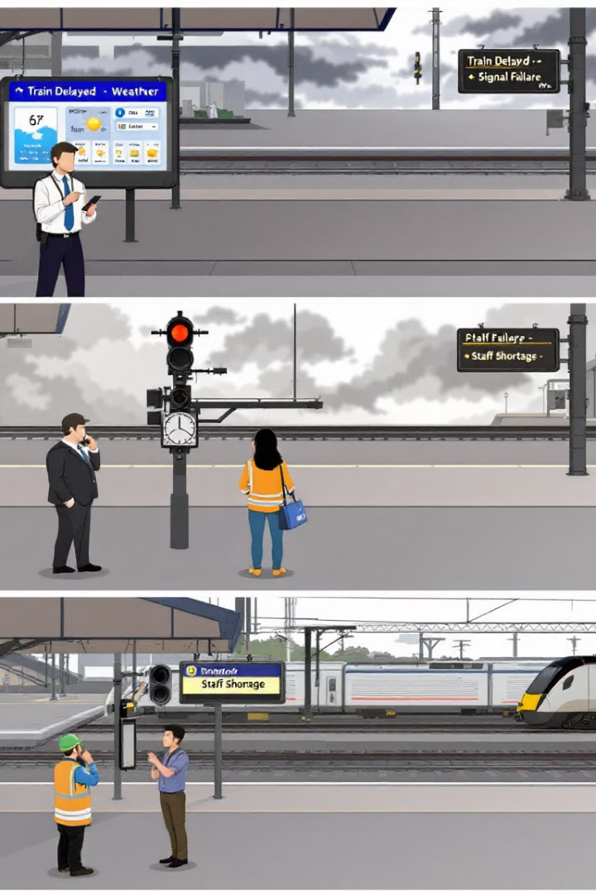
Refund Request Analysis
1
Weather
2
Signal Failure
Weather-related disruptions, especially during winter, significantly impact train schedules. Severe weather events lead to delays and subsequent refund requests from affected passengers, underlining the need for robust weather contingency plans.
Signal failures continue to be a major source of delays. Addressing these technical issues requires investment in modern signalling systems and proactive maintenance to minimise disruptions and maintain passenger trust.
3
Staff Shortage
Staff shortages, whether due to illness, holidays, or inadequate staffing levels, can cause significant delays. Effective resource planning and staffing strategies are crucial for ensuring consistent service delivery and reducing refund requests.

Slide 4
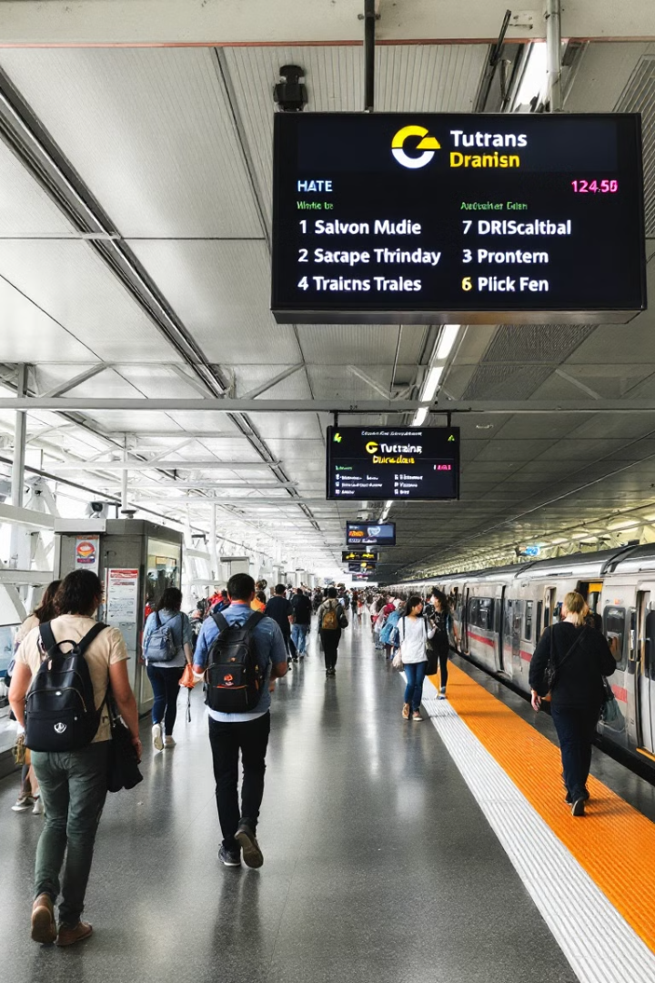
General Performance
Revenue Performance
Operational Efficiency
Revenues are generated with opportunities for increased sales through targeted marketing. Enhancements to the station environment and passenger services could attract more customers and boost financial returns.
Improving operational efficiency involves streamlining processes and optimising resource allocation. Reducing delays and improving customer flow can enhance overall performance.
Customer Satisfaction
Monitoring customer satisfaction is essential. Gathering feedback and addressing passenger concerns can drive loyalty and positive word-of-mouth, ultimately supporting revenue growth.

Slide 5
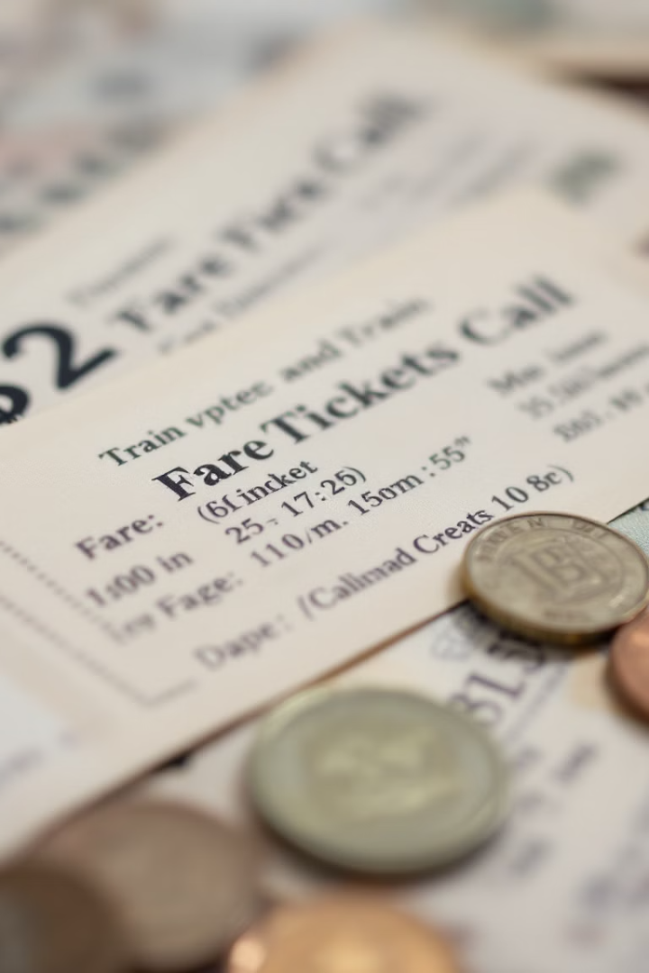



Revenue Streams
Ticket Sales
Ticket sales form the core revenue stream for UK railways, encompassing various ticket types. Optimising pricing strategies and enhancing online booking systems can drive sales and overall revenue growth.
Ancillary Services
Ancillary services, such as food, beverages, and retail outlets at stations, provide additional revenue opportunities. Improving the quality and variety of these services can enhance passenger experience and drive sales.
Government Subsidies
Government subsidies play a crucial role in supporting railway operations and infrastructure. Effective management and allocation of these funds are essential for ensuring the long-term sustainability of the network.

Slide 6




Factors Influencing Revenue
Economic Conditions
Government Policies
Technological Advancements
Economic growth directly influences passenger travel and freight transport. Monitoring economic indicators and adapting strategies to suit market conditions are key to maintaining revenue levels.
Government policies, including infrastructure investments and regulatory frameworks, shape the operating environment. Engaging with policymakers and advocating for supportive measures can safeguard revenue streams.
Technological innovations, such as improved signalling and passenger information systems, enhance efficiency and attract passengers. Investing in and adopting new technologies can drive long-term revenue growth.

Slide 7
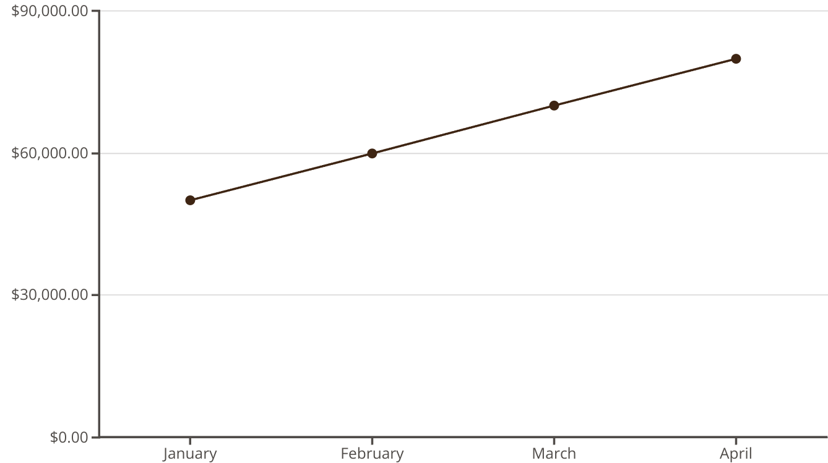
Monthly Revenue Analysis
The line chart illustrates the trend of monthly revenue over the first four months of the year. The steady increase in revenue from January to April demonstrates a positive trajectory, indicating successful strategies and growing passenger demand.

Slide 8
Recommendations
Optimise Operations
1
Streamline processes and resource allocation to enhance efficiency and reduce delays.
Invest in Technology
2
Adopt innovative solutions to improve signalling, passenger information, and booking systems.
Enhance Customer Experience
3
Gather feedback, address concerns, and provide quality ancillary services to drive loyalty.
These measures will support informed decision-making and contribute to the long-term financial health and sustainability of the UK railway network. We should focus on better understanding, and creating strategies to make weather delays less impactful.

